Slide 1
COMP 4290
Week 11 - Wednesday

Slide 2
Last time
What did we talk about last time?
Finished database reliability and integrity
Sensitive data
Database inference

Slide 3
Questions?

Slide 4
Project 3

Slide 5
Assignment 4

Slide 6
Anu Regmi Presents

Slide 7
Data Mining

Slide 8
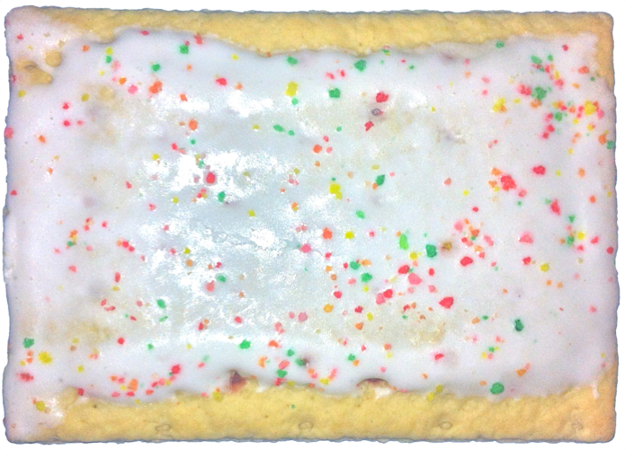


Data mining
What do Walmart, hurricanes, and Pop-Tarts have to do with one another?
A 2004 NY Times article says that Walmart's analysis shows the demand for strawberry Pop-Tarts goes up by a factor of 7 before a hurricane makes landfall
But the top selling item is beer

Slide 9
Data mining
Data mining means looking for patterns in massive amounts of data
These days, governments and companies collect huge amounts of data
No human being could sift through it all
We have to write computer programs to analyze it
It is sort of a buzzword, and people argue about whether some of these activities should simply be called data analysis or analytics

Slide 10
What is data mining?
We have huge databases (terabytes or petabytes)
Who is going to look through all that?
Machines of course
Data mining is a broad term covering all kinds of statistical, machine learning, and pattern matching techniques
Relationships discovered by data mining are probabalistic
No cause-effect relationship is implied

Slide 11
What can you do with it?
It is a form of machine learning or artificial intelligence
At the most general, you can:
Cluster analysis: Find a group of records that are probably related
Like using cell phone records to find a group of drug dealers
Anomaly detection: Find an unusual record
Maybe someone who fits the profile of a serial killer
Association rule mining: Find dependencies
If people buy gin, they are also likely to buy tonic

Slide 12
Privacy
Social media providers have access to lots of data
Facebook alone has details about more than 3 billion people
Can they find hidden patterns about your life?
Should they inform the police if they think they can reliably predict crime?
What about data the government has?
For research purposes, some sets of "anonymized" data are made public
But researchers often discover that the people involved can be discovered anyway

Slide 13
Data mining issues
Privacy issues are complex
Sharing data can allow relationships to become evident
These relationships might be sensitive
Integrity
Because data mining can pull data from many sources, mistakes can propagate
Even if the results are fixed, there's no easy way to correct the source databases
Data mining can have false positives and false negatives

Slide 14
Cloud Computing

Slide 15
Cloud computing
Cloud computing are flexible, Internet-based services that gives users access to computational resources on demand
Cloud computing allows small companies to store and process data without the up-front costs of a data center
Cloud computer services are growing rapidly, fueled by:
High-speed networking
Low cost computers and storage
Hardware virtualization technology
Demand for AI

Slide 16
Defining characteristics
Since cloud computing is a buzzword, we want to define clouds as having five characteristics:
On-demand self-service: You can ask for more resources
Broad network access: You can access services from lots of platforms
Resource pooling: The provider has lots of stuff for you to use that can be dynamically assigned
Rapid elasticity: Services can quickly and automatically be scaled up or down
Measured service: You pay for computing like a utility

Slide 17
Service models
Infrastructure as a Service (IaaS)
Processing, storage, and networks are in the cloud
You get (virtual) machines, but you're responsible for what's on them
Platform as a Service (PaaS)
Languages, tools, and APIs are provided
You have to develop applications
Software as a Service (Saas)
You get everything
You're using software and doing computations, but it's happening in the cloud

Slide 18
Another look at service models
Applications
Application Platform:
Tools and APIs
Virtual Machines and Storage
Administered
by SaaS
Administered
by PaaS
Hypervisor
Administered
by IaaS
Hardware

Slide 19
Deployment models
Private cloud: the cloud infrastructure is operated by and for the owning organization
Community cloud: the cloud is shared by organizations usually with a common goal
Public cloud: owned and operated by for-profit companies that make the service available to everyone
Hybrid cloud: two or more clouds connected together

Slide 20
Moving to the cloud
Should your business move to the cloud?
There are steps you should take to determine the risk and value of doing so:
Identify assets you want to move to the cloud
Determine what additional vulnerabilities you will have on the cloud
Estimate the likelihood that those vulnerabilities will be exploited
Compute expected loss
Select new controls
Project total savings
It may or may not save you money to move the cloud

Slide 21
Picking a provider
Which model should you use?
Even if you want public, there are many choices:
Amazon Web Services
Google App Engine (PaaS)
Google Compute Engine (IaaS)
Microsoft Azure (PaaS and IaaS)
Important issues:
Authentication and access control
Encryption
Logging
Incident response
Reliability
Vendor lock-in makes it hard to change providers

Slide 22
Cloud security tools
Just using the cloud can have security benefits
Geographic diversity
Platform diversity
Infrastructure diversity
Cloud platforms often support mutual authentication
Cloud storage
There are risks when you share data on a platform
Consider how sensitive the data is
Consider how data sharing will be done
Are there laws or other regulations that apply?
Side channel attacks may be possible against other users of the same cloud

Slide 23
Huge Dropbox mistake
Dropbox is a popular cloud service for backing up and synchronizing data
On June 19, 2011, a bug in their software accepted any password for any account
Dropbox said that files would be encrypted using the user password
But they weren't!
When using a cloud service, it pays to look into the details

Slide 24
Cloud identity management
Managing identities and authentication in a cloud can be challenging:
There are many computers communicating with each other
A hybrid cloud may have different authentication requirements within it
Federated identity management is sharing identity information across different trust domains
There are systems for it, but it's a complex problem
It can provide single sign-on capabilities

Slide 25
Securing IaaS
IaaS gives the user a lot of control
In other words, ways to be unsecure
IaaS hosts can usually be controlled in more ways than traditional hosts
Good because it allows for robust logging and monitoring
Bad because there are more vulnerabilities attackers can try
If you delete a file, it might not be gone, and someone else might be using the same hardware
Authenticate command line interfaces strongly
Use virtual machines that will only run specific applications
Application whitelisting

Slide 26
Upcoming

Slide 27
Next time…
Privacy laws
Web privacy
Ashley Gutierrez presents

Slide 28
Reminders
Read Sections 9.1 – 9.5
Work on Project 3
Passwords and secret phrases due this Friday!
Start Assignment 4
Exam 2 is next Monday
We'll review on Friday

